Slide 1
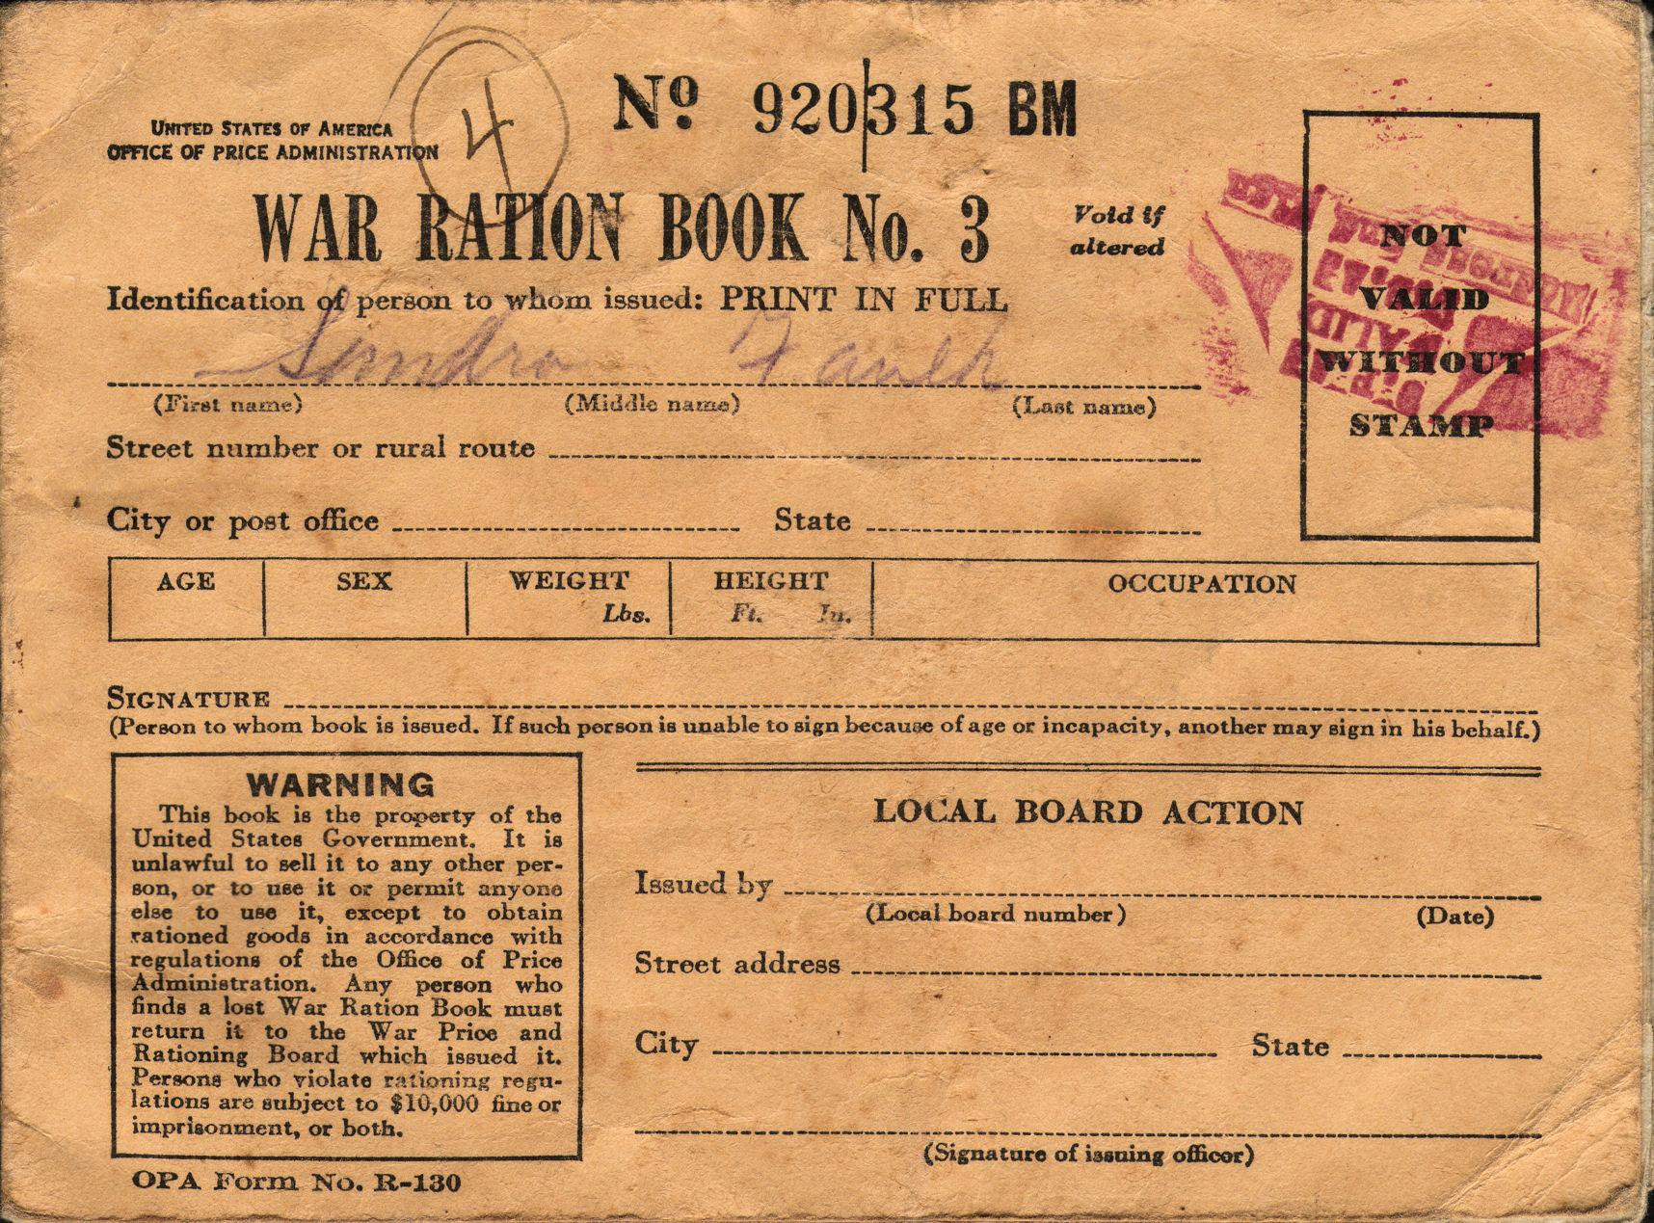
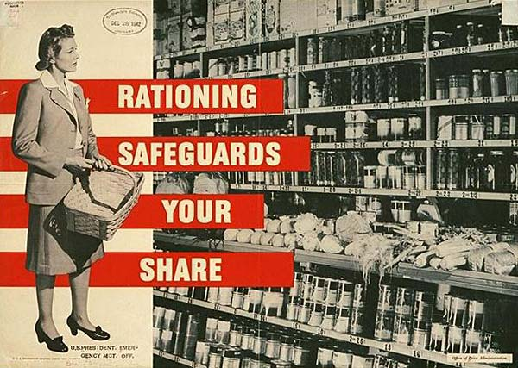

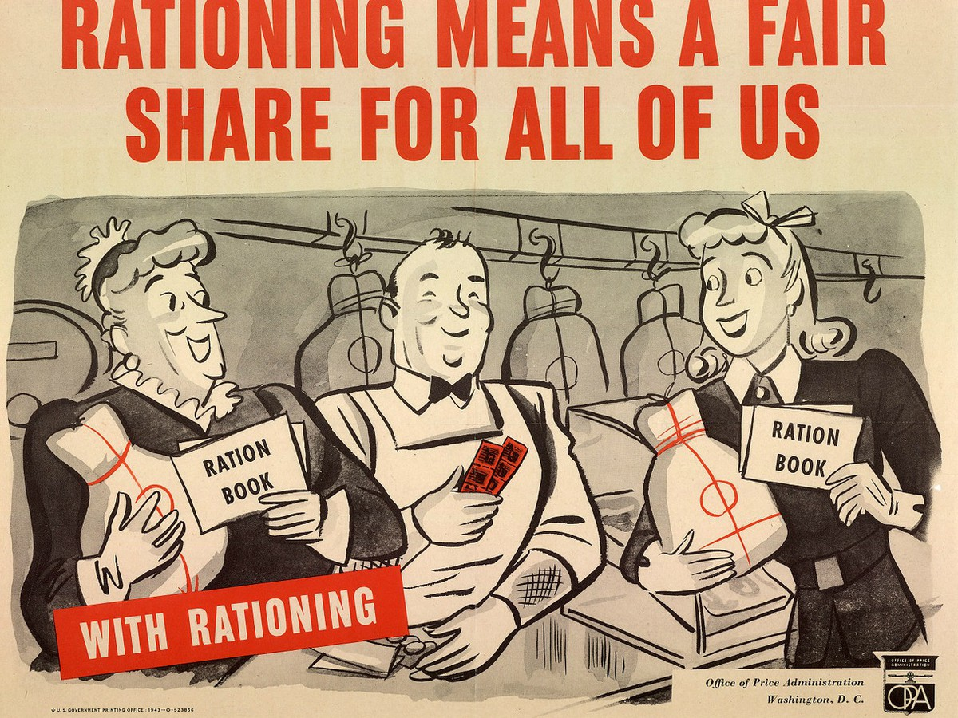
Rationing Simulation

Slide 2
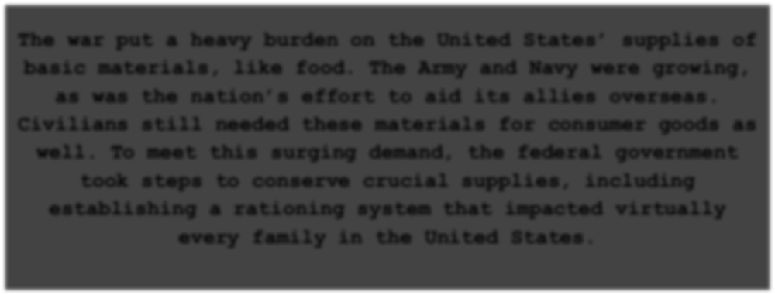
Rationing Simulation
The war put a heavy burden on the United States’ supplies of basic materials, like food. The Army and Navy were growing, as was the nation’s effort to aid its allies overseas.
Civilians still needed these materials for consumer goods as well. To meet this surging demand, the federal government took steps to conserve crucial supplies, including establishing a rationing system that impacted virtually every family in the United States.

Slide 3
Rationing Simulation
Instructions
You have been given
$2.00 and 48 ration points to purchase items to feed your family of four. You must create a balanced menu for breakfast, lunch and dinner without exceeding your spending limit or number of points.
Rules
You need to have at least 1 vegetable and 1 fruit at each meal.
You need to have some type of protein (meat, eggs, nuts) and some type of grain (bread, rice, grits) at each meal.
You need to have at least one non-water beverage
during the day.
You must use BOTH ration points and money. You can NOT buy smaller quantities than what is listed.
Consider portions. For example, a loaf of bread can be used all day, but a bottle of Coke is only 1 serving.
If you are using the same item for more than one meal, you should list it on your menu, but you don’t have to add it to your shopping list. Be sure to write “SA” (see above) next to the item on your menu.
Finally, your meal cannot be disgusting. If you have to ask, it probably is...

Slide 4
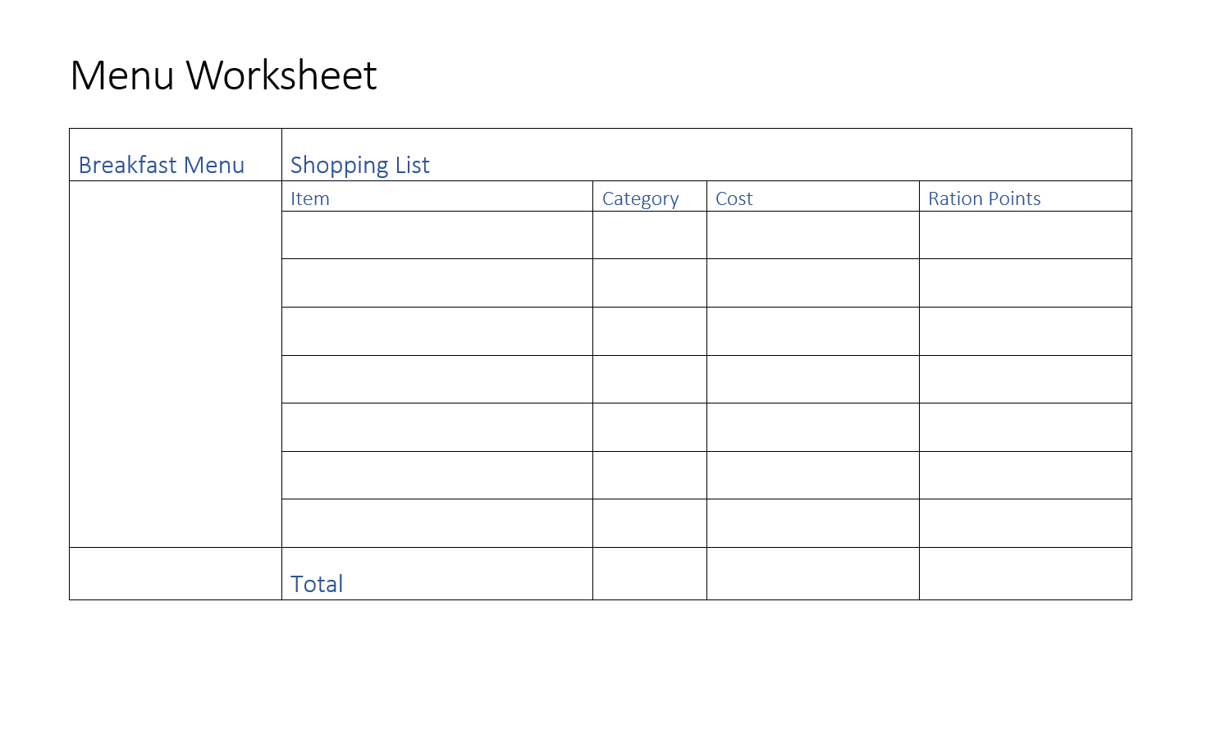
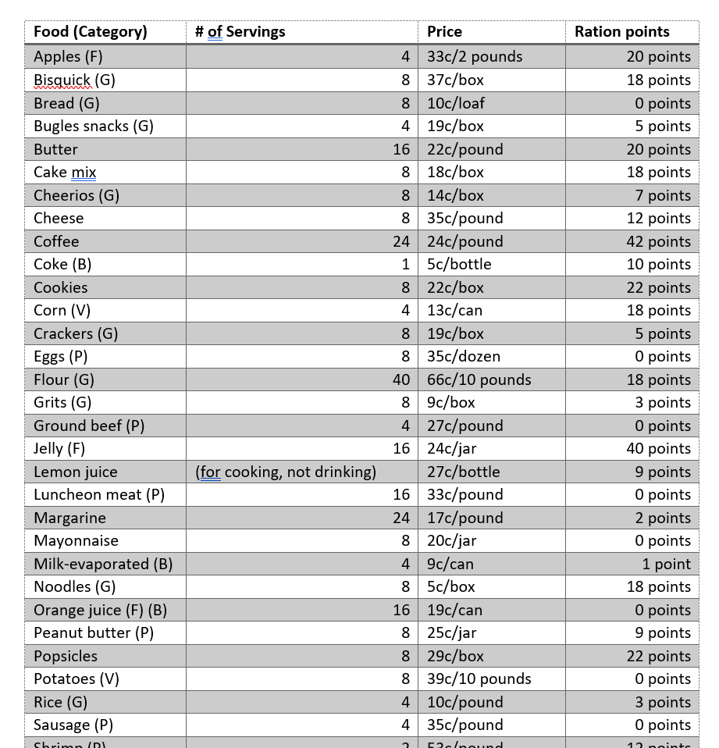

Slide 5
Rationing Simulation
Discussion
What was more difficult: not spending too much money or not using to many points and why?
How might having a victory garden at home have made this activity easier?
What are some benefits of a rationing system?
What is a disadvantage of a rationing system?

