Slide 1
McCarthyism and the Red Scare

Slide 2
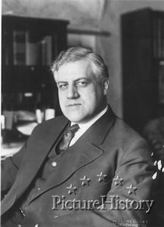
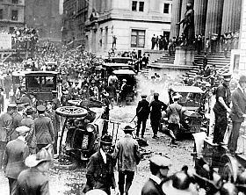
Nothing new
A. Mitchell Palmer
Mass Hysteria
Terrorist attacks (Wall St.)
Deportations

Slide 3
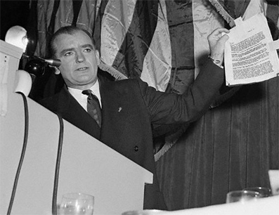
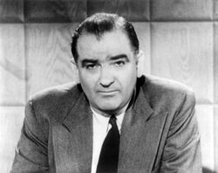
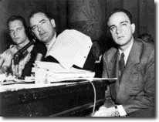
Sen. Joseph McCarthy
Bio
Wheeling Speech
Primary sources

Slide 4
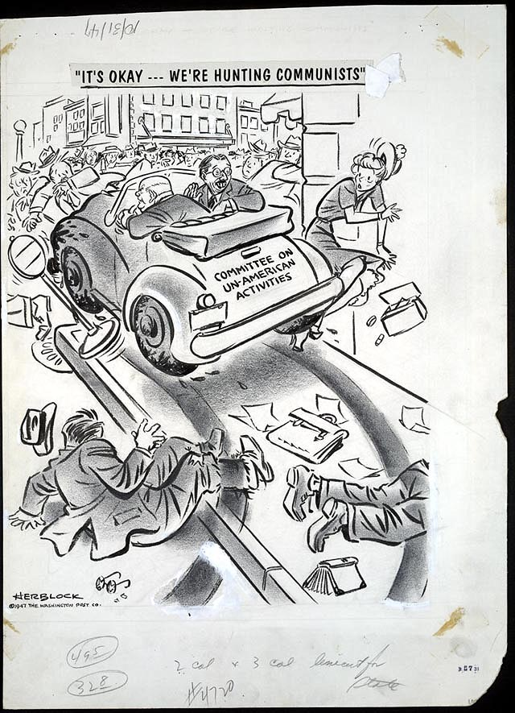
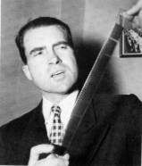
HUAC
Questions asked
5th Amendment

Slide 5
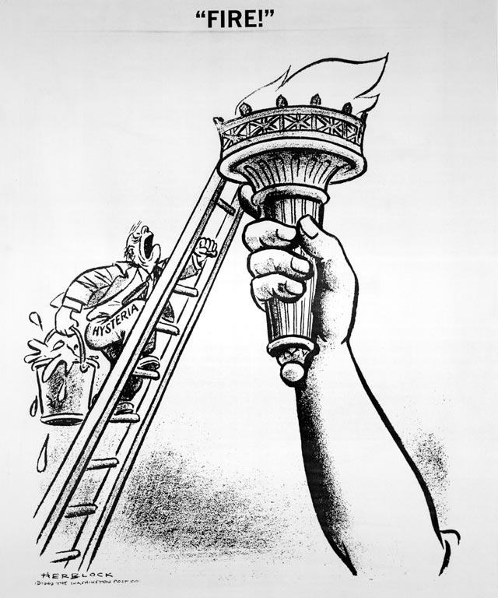
-June 1949-
What is the Washington Post cartoonist portraying in his drawing?

Slide 6
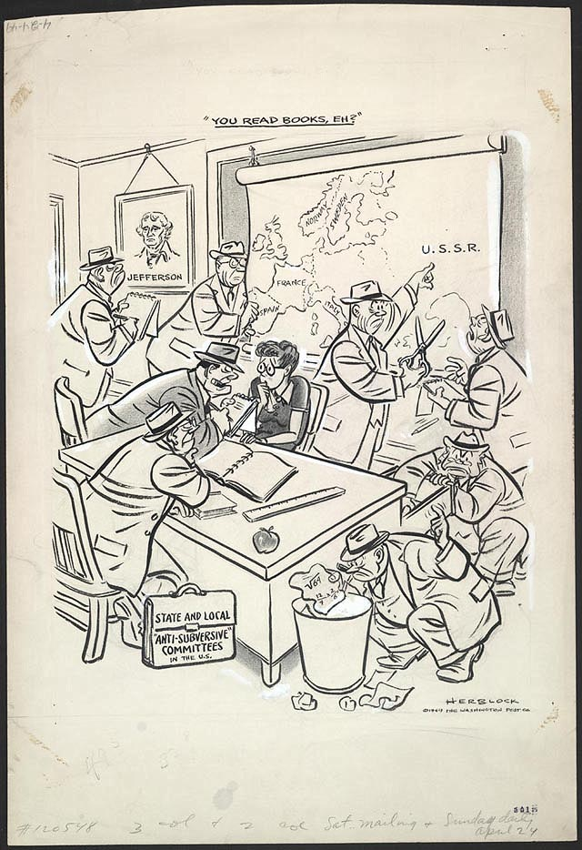
-April 1949-
"You read books, eh?"
During the postwar anti-communist campaign hundreds of elementary and high school teachers were investigated and lost their jobs, sometimes as a result of being named by proliferating "anti-subversive" groups and individuals. Some individuals compiled and circulated their own blacklists, which were accepted by frightened employers and casting directors who feared being blacklisted themselves if they sought facts and fair play. The motives of some self-serving or vindictive accusers were summed up by Herb Block in a phrase: "If you can't crush the commies, you can nail a neighbor."

Slide 7
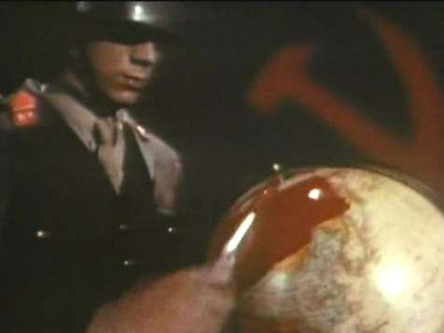
Misconceptions
Name
Length
Soviets painting the world red with blood

Slide 8
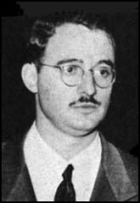
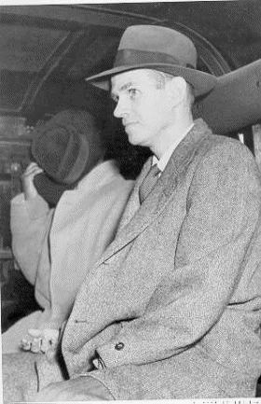
Success
Alger Hiss
Julius Rosenberg

Slide 9
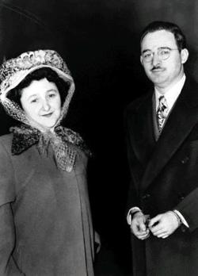
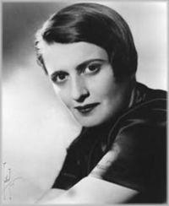
Failure
Ethel Rosenberg
Ayn Rand

Slide 10
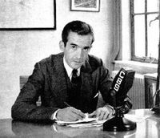
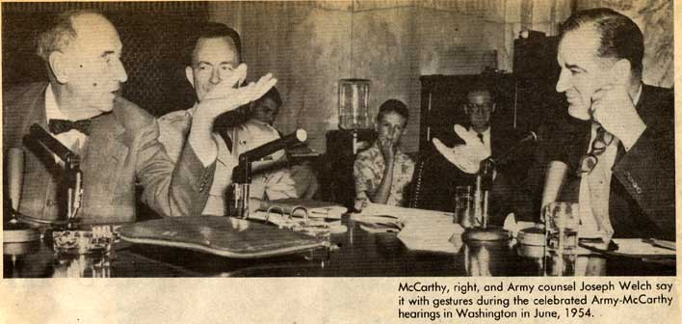
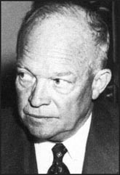
Too Far
Ike and the Army
Edward R. Murrow
Movie clip

Slide 11
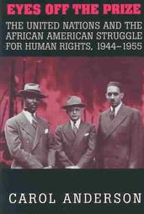
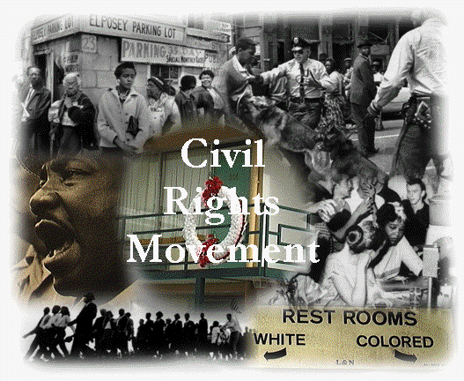
Consequences
African Americans struggle
Human rights vs. Civil Rights

Slide 12
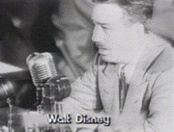
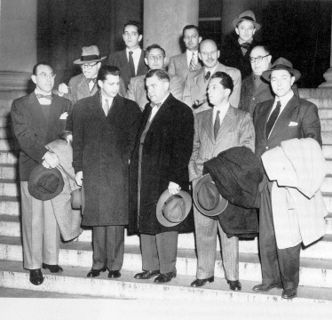
Entertainment Industry
Hollywood Ten
-Even W. Disney had to appear before HUAC.
-The ten men were convicted of contempt. Their appeals of course were denied, all served prison terms of up to one year.

Slide 13
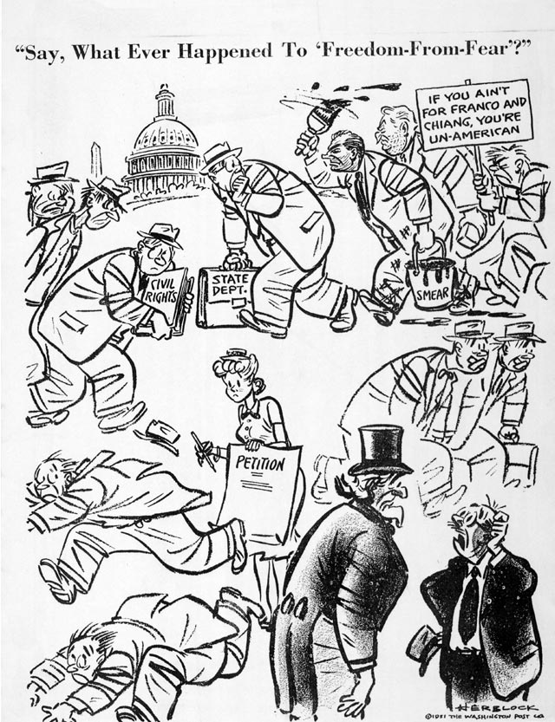
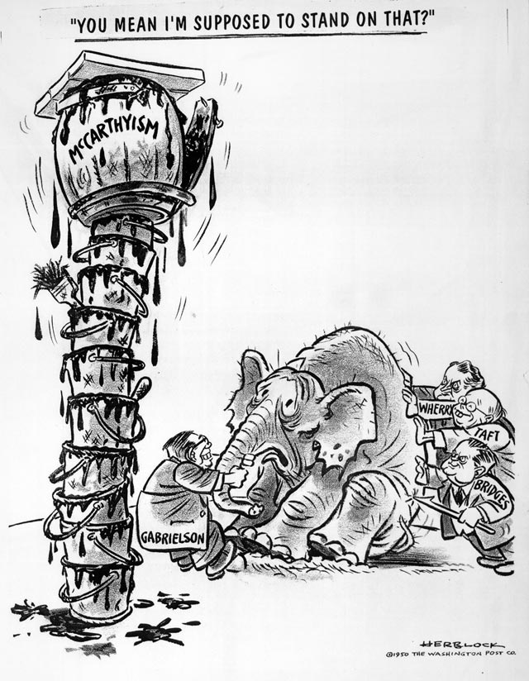
World view
Political chill in America
Joseph McCarthy

