Slide 1

1959 Steel strike
Conflict, resolution and legacy

Slide 2

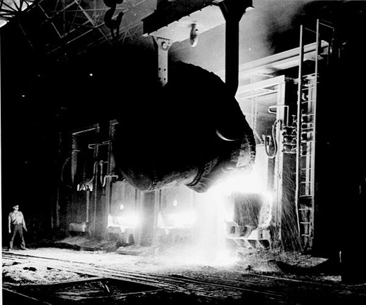
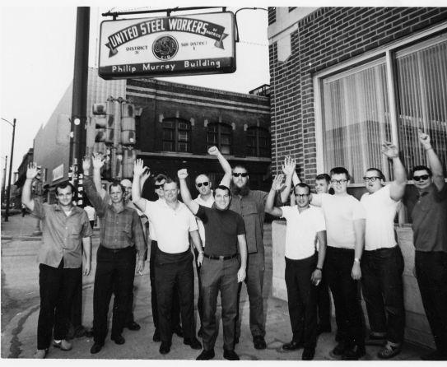
1959 Steel strike
Leading to 1959 Strike
Steel Outlook
1959 Strike
Effects

Slide 3
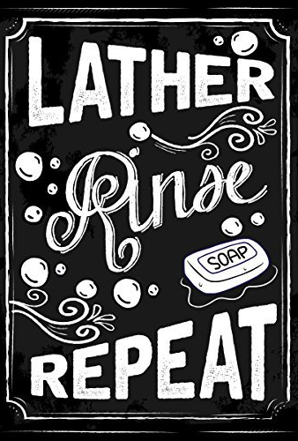
Union tensions before 1959
Union takes a position
Steel Produces take a position
A deadlock is threatened
Agreement reached at the last minute

Slide 4
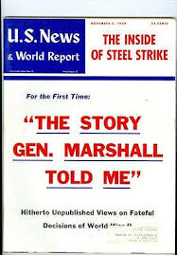
Marshall plan
Concentrated on rebuilding manufacturing infrastructure
Imported 1000s of tons of steel for rebuilding
European and Japanese steel is used to replace imported American Steel

Slide 5
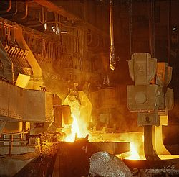
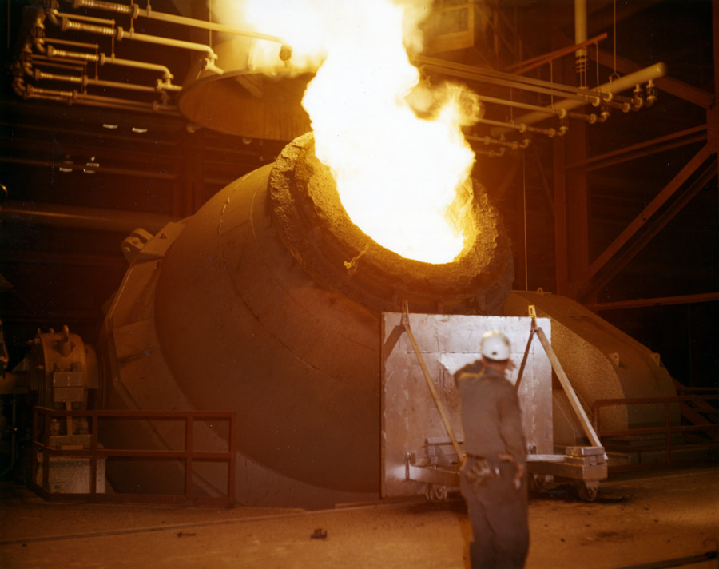
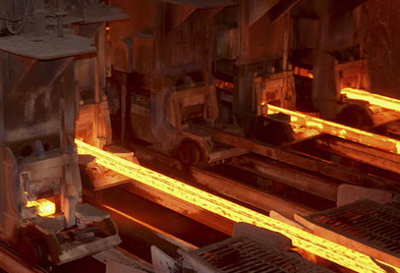
Technology
Basic Oxygen Process
Continuous Casters
Built in Europe and Japan during the 1950s.
40 to 50% cheaper to build then open-hearth and 25% less to operate

Slide 6
The distinguishing characteristic of the American steel industry is its tremendous productiveness, a quality which other countries have been unable to emulate so far,” later adding that the company had examined the methods popular in Europe but found them wanting.
1957 Steel Hearing Meetings with the United States Senate

Slide 7
1959 Preparation for strike
Union
Steel Producers
Union Envy
Saw record profits
Ensure stability and longevity of employment
Reduced exports
Excess capacity
Desire to reduce labor per ton

Slide 8
Steel producers would not budge on the elimination of Section 2-B from the industry standard collective bargaining agreement. First secured by the USWA in 1947, 2-B established that steel mill managers could not alter established work practices unless the introduction of new technology required it.
Key Tipping Point

Slide 9

Strike timeline
April 10 – Industry proposes one year freeze and a $.17 cost of living increase
June 25 – Eisenhower appoints a government Board to mediate
July 1 – Wildcat strike starts in some steel plants
July 15 – Steel Strike begins
July 20 – Federal mediation begins (Labor Secretary Mitchell)
August 23 – Eisenhower informs both parties that government has no plans to intervene

Slide 10
Strike timeline
September 8 – Eisenhower informs both parties to negotiate in good-faith
October 9 - Presidents meets with cabinet to invoke the Taft-Hartley Act
October 10 – November 2 – various court cases between USW and Steel Producers
November 7 – Supreme court upholds the Taft-Hartley injunction. Works must go back for 80 days.
December 31 – USW and Steel Producers meet with Vice President Nixon
January 4 – Settlement is reached

Slide 11
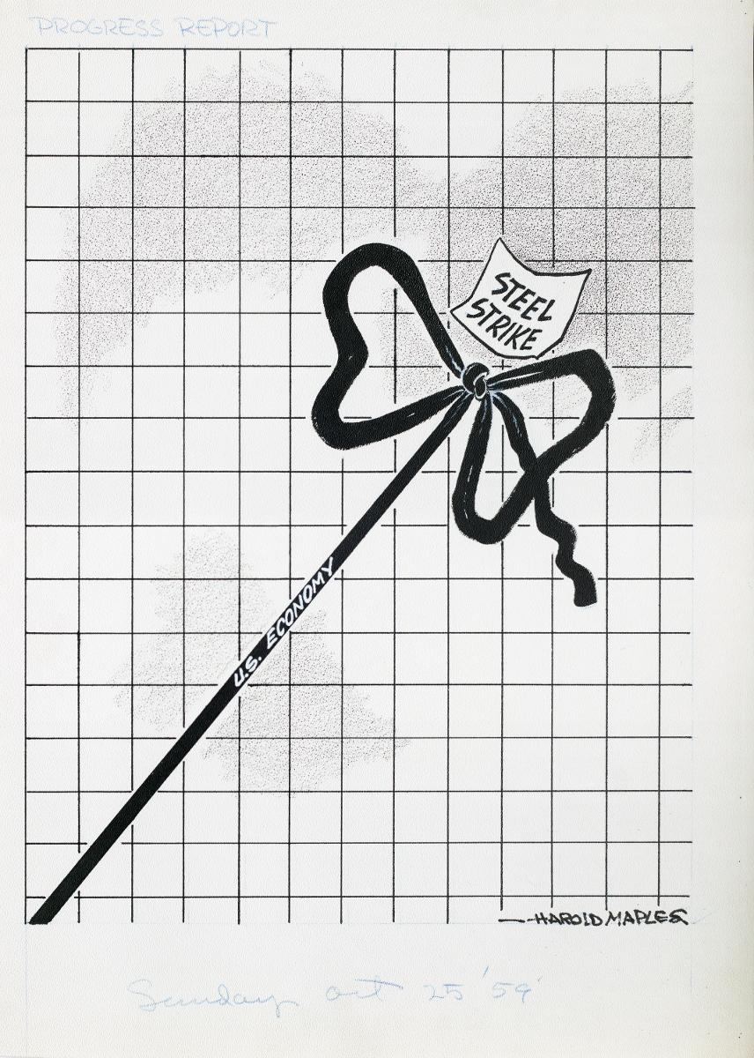
Strike short term results
Imported Steel increases by 30% year to date
Exported Steel decreased to near 0
Most foreign mills established frameworks and infrastructure for efficient exports

Slide 12
In the 10 years starting in 1948, American steel mills averaged nearly 700,000 workers. Today only 83,000 people still work in the nation's steel mills.
Death of American Steel

Slide 13
Research
Government Reports available from the National Archives
Notes from Nixon and Eisenhower Library
Notes and memos from Penn States collection of David J. McDonald

Slide 14
Challenges
Most of the information is in private hands
Steel Producers Layoff information
USW Economic forecast reports

Slide 15

Thank You!
someone@example.com

